Slide 1


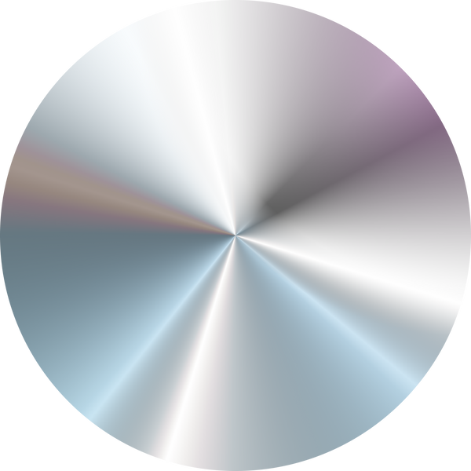
Autonomous driving car using AI
Md. Waliur Rahman - 2011306042
A.F.M Khairul Amin 2012815642
Abdullah Al-Galib Id- 1712986642
Kazi Mainul Kaysar ID-2011615042
Group: 3
group:3
A.F.M Khairul Amin 2012815642
Md. Waliur Rahman - 2011306042
Abdullah Al-Galib Id- 1712986642

Slide 2

PROJECT OVERVIEW
Our project focuses on developing an autonomous car driving system powered by machine learning techniques.
The goal is to enable a vehicle to navigate safely and efficiently without human intervention.
Using computer vision and machine learning, the system perceives the environment, detects objects, and makes real-time driving decisions.
group:3
A.F.M Khairul Amin 2012815642
Md. Waliur Rahman - 2011306042
Abdullah Al-Galib Id- 1712986642

Slide 3
DATASET: BDD100K - IMAGES 10K
01
02
03
Purpose: Train and evaluate our model using the BDD100K dataset, widely used in the automotive industry for tasks like instance segmentation, semantic segmentation, and object detection.
Diversity: Includes diverse driving scenes with various weather conditions, times of day, and urban/rural environments, ideal for building a robust autonomous driving model.
Scope: We will use a smaller sample of the dataset due to the computational limitations of our devices.
group:3
A.F.M Khairul Amin 2012815642
Md. Waliur Rahman - 2011306042
Abdullah Al-Galib Id- 1712986642

Slide 4
Project Goals
Improve safety and efficiency by reducing mistakes in detecting objects.
Enable seamless integration with autonomous vehicle control systems.
Develop a highly accurate machine learning model for real-time perception.
group:3
A.F.M Khairul Amin 2012815642
Md. Waliur Rahman - 2011306042
Abdullah Al-Galib Id- 1712986642

Slide 5
KEY TECHNOLOGY
Deep Learning Frameworks:
Dataset Processing:
For result
TensorFlow/PyTorch
Dataset Processing: OpenCV, NumPy, Pandas
view result graph we use math plot .
Neural Network Models: CNNs, RNNs
group:3
A.F.M Khairul Amin 2012815642
Md. Waliur Rahman - 2011306042
Abdullah Al-Galib Id- 1712986642

Slide 6
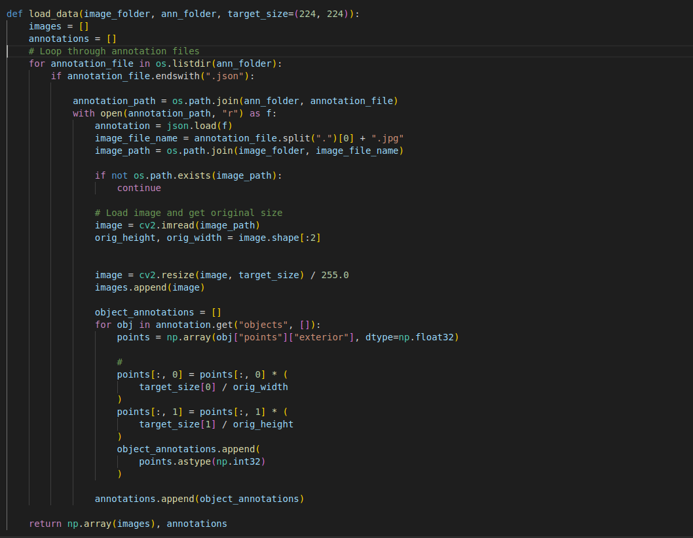
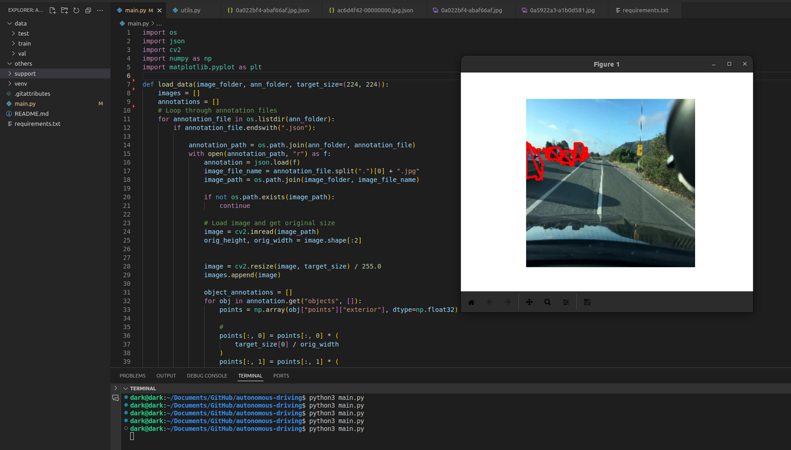
sample code for Annotation and access datasets :
group:3
A.F.M Khairul Amin 2012815642
Md. Waliur Rahman - 2011306042
Abdullah Al-Galib Id- 1712986642

Slide 7
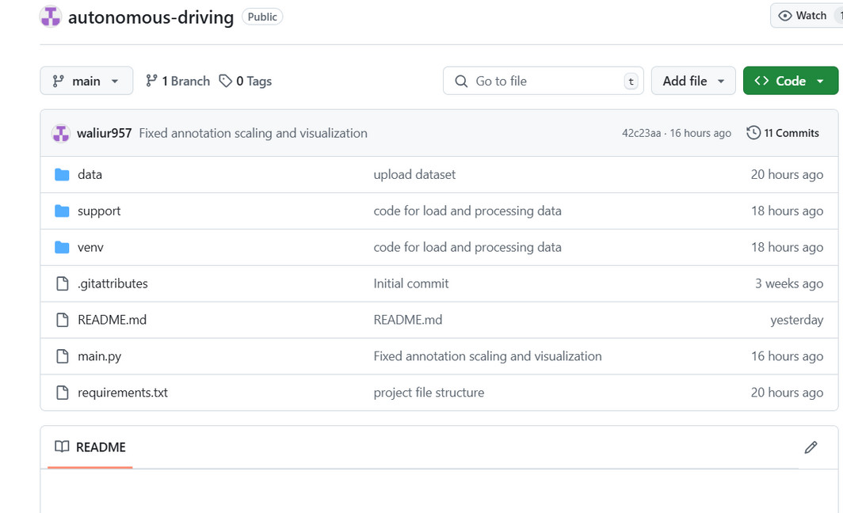
Github Repository
Github Repository link: https://github.com/waliur957/autonomous-driving
group:3
A.F.M Khairul Amin 2012815642
Md. Waliur Rahman - 2011306042
Abdullah Al-Galib Id- 1712986642

Slide 8
FUTURE STEPS :
02
03
01
Further Enhancements: Future work will involve
improving the model by experimenting with different
architectures and hyperparameters.
Model Training: The model will be trained using the
BDD100K dataset to detect lanes and objects in the
images.
Testing and Evaluation: After training, the model will
be tested on the validation set, and its performance will
be evaluated based on accuracy and speed.
group:3
A.F.M Khairul Amin 2012815642
Md. Waliur Rahman - 2011306042
Abdullah Al-Galib Id- 1712986642

Slide 9
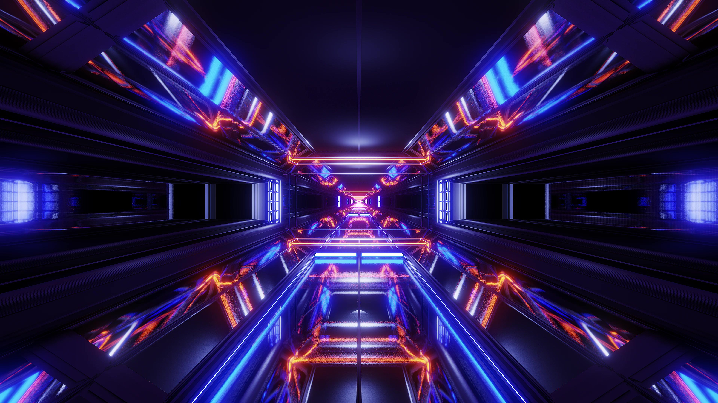
CONCLUTION
and model setup. The BDD100K
Dataset has been successfully integrated into the project, and
image processing tasks have been handled using OpenCV
and Matplotlib. The next steps involve training the model
and testing its performance for accurate lane and object
detection.
The autonomous driving machine learning model is pro-
gressing well. The initial stages focused on data preprocessing-
ing, annotation handling,
group:3
A.F.M Khairul Amin 2012815642
Md. Waliur Rahman - 2011306042
Abdullah Al-Galib Id- 1712986642

